Slide 1
ASG visualizer Tutorial
Using the Alert Summary Graph alongside Kibana

Slide 2
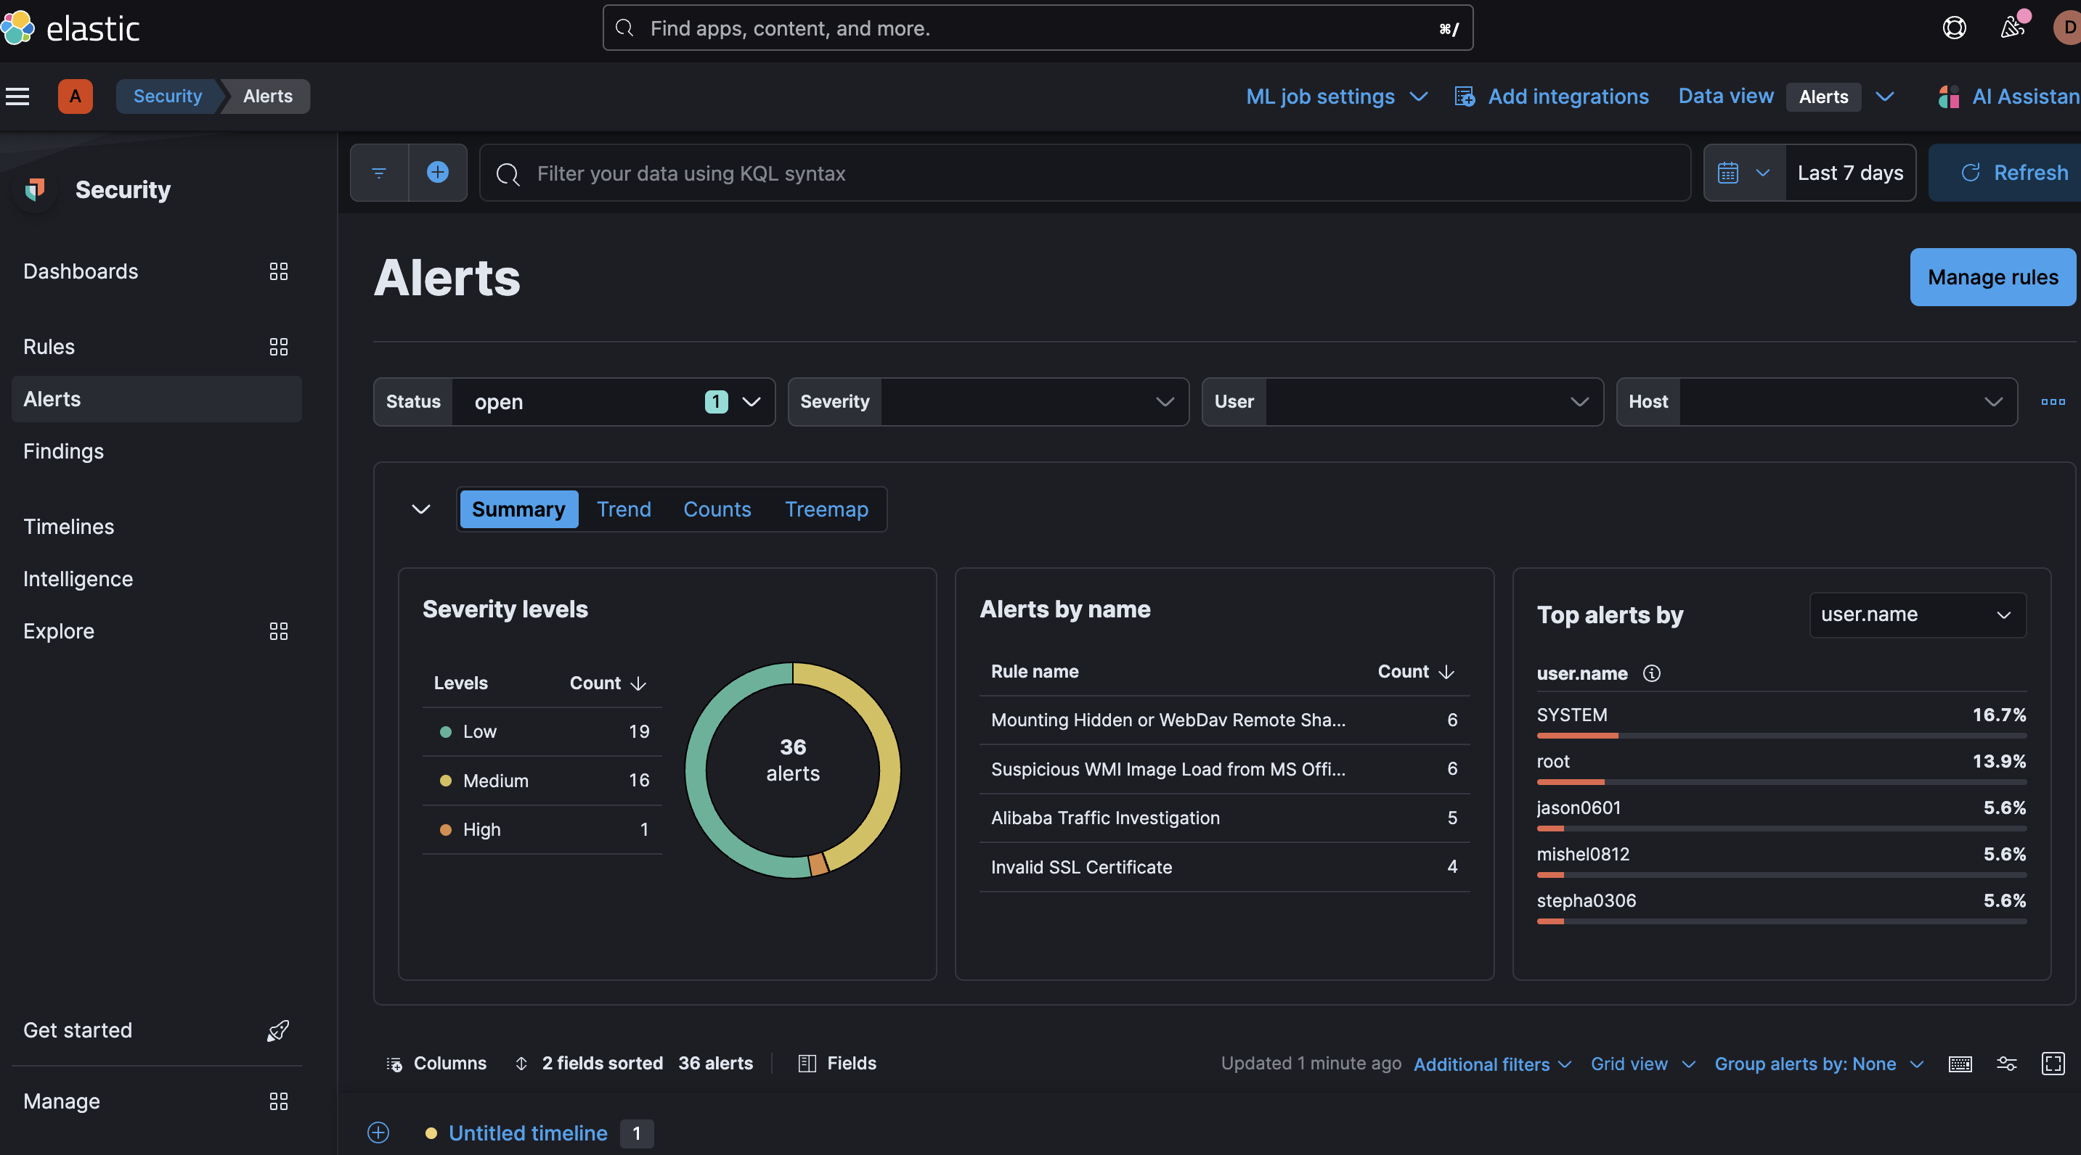
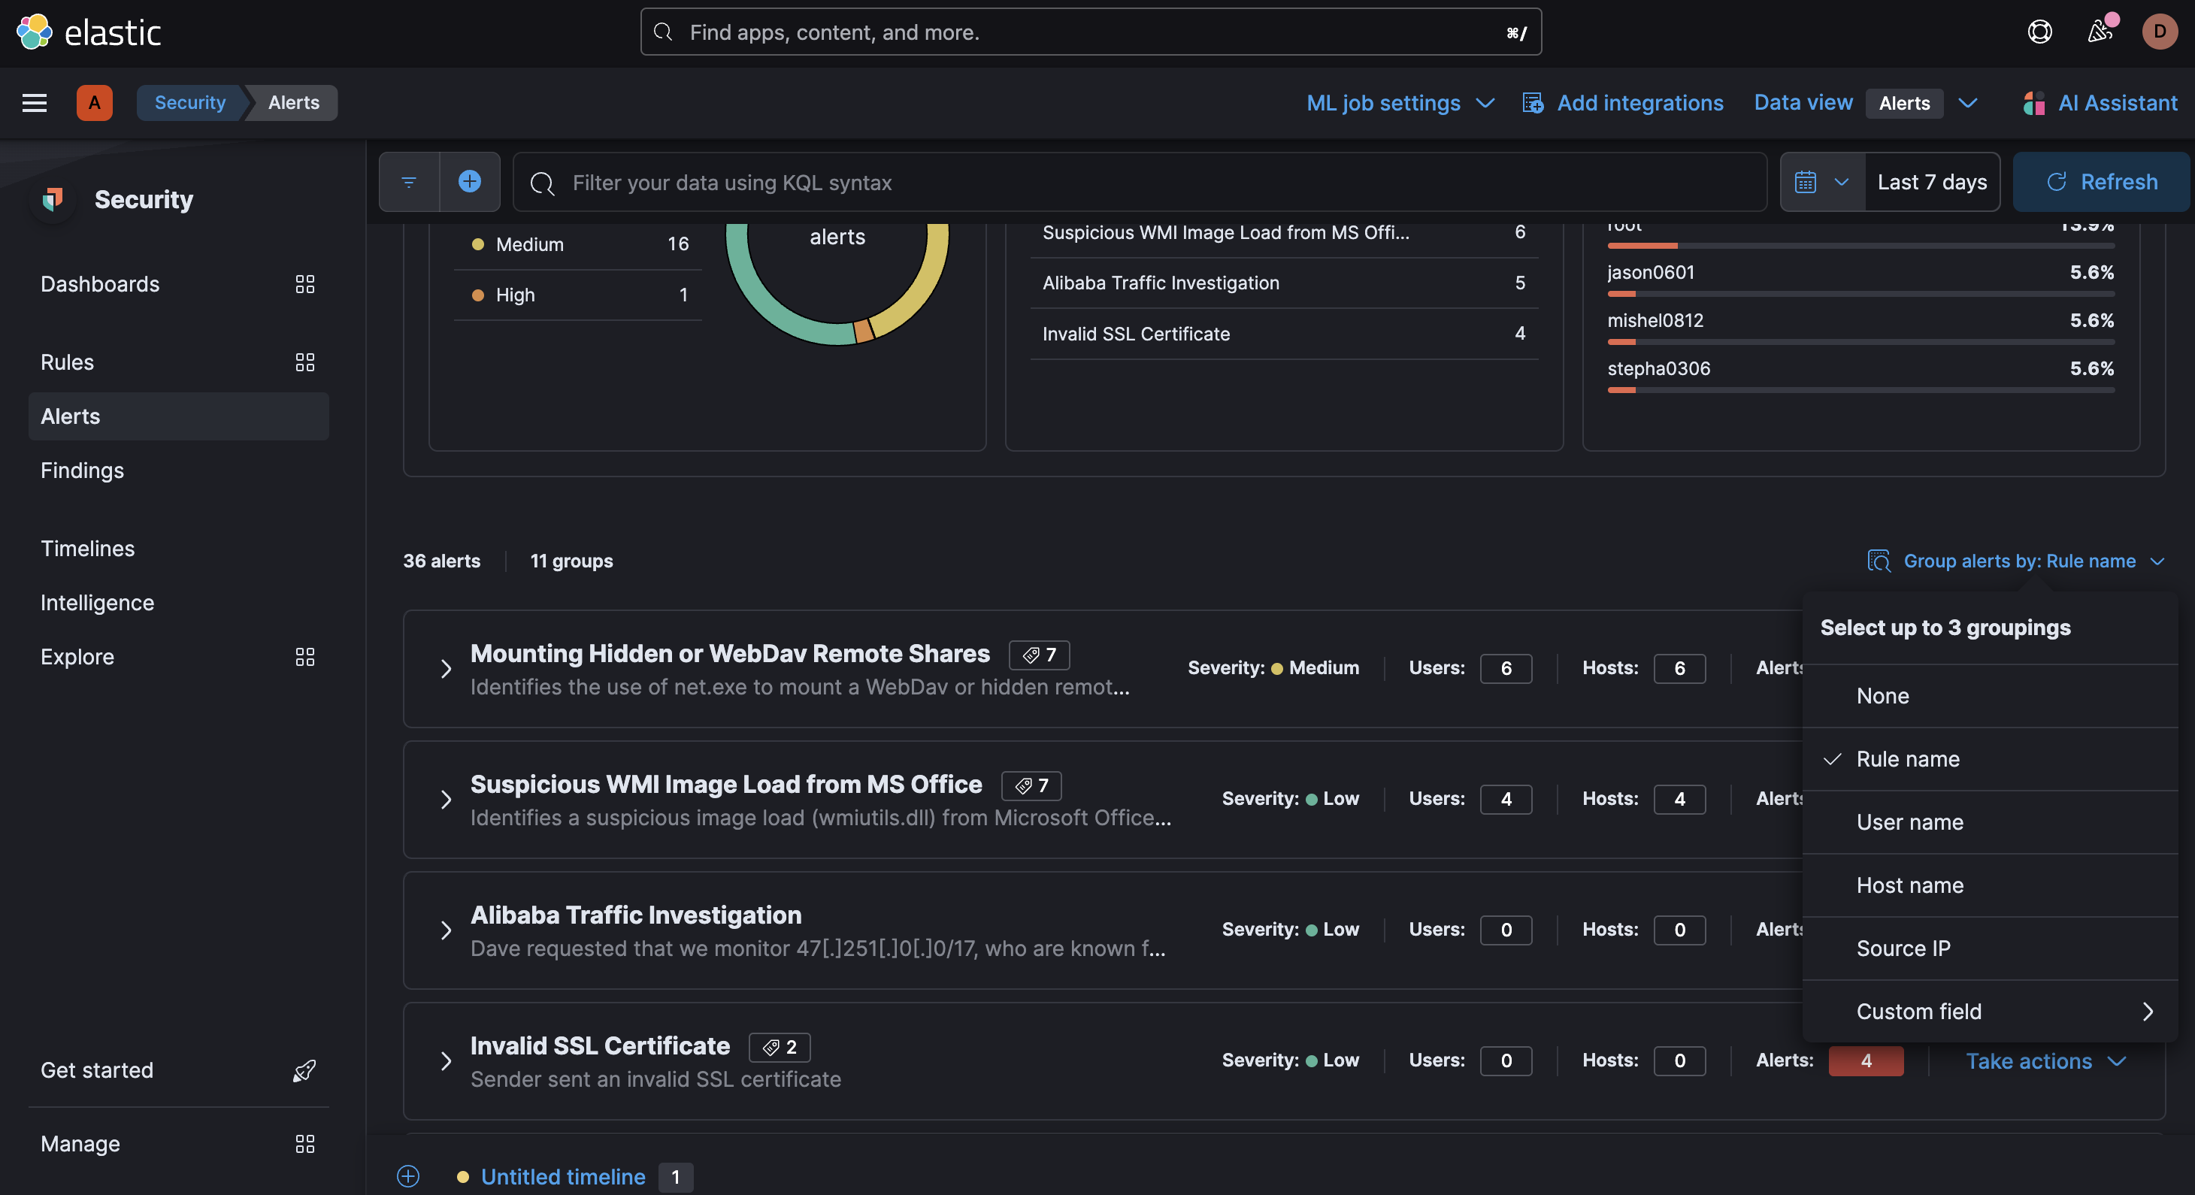
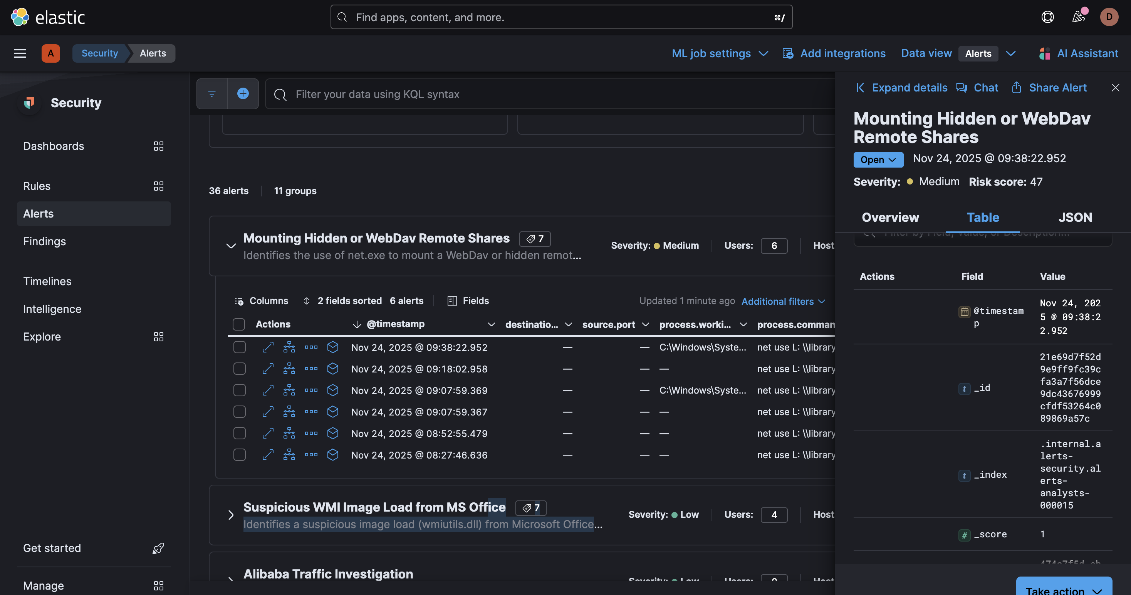
Big Picture: What Is the ASG visualizer?
Goal: Use Kibana + ASG visualizer together to understand an incident.
Companion tool to Kibana's Security → Alerts view.
Shows alerts and related activity as a map of icons and lines.
Each icon = object on the host (alert, host, process, file, network).
Each line = relationship (e.g., process connects to IP, reads file).

Slide 3
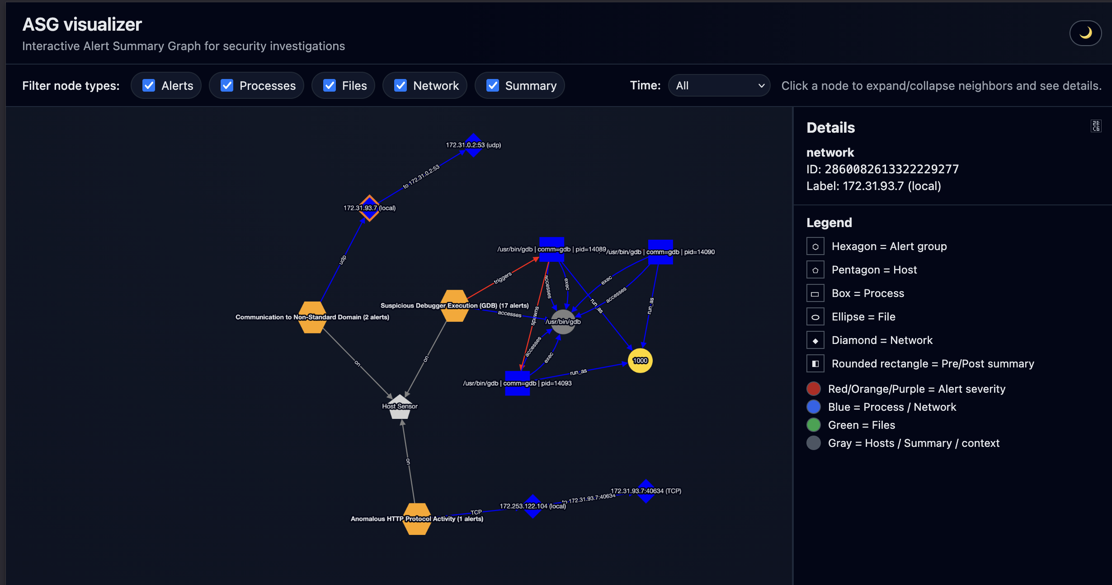
Workflow: From Kibana to ASG visualizer
In Kibana, go to Security → Alerts.
Pick the alert specified in the exercise and note rule, host, and time.
Open the ASG visualizer URL in a new browser tab.
Locate the alert hexagon whose label matches the rule name.

Slide 4
ASG visualizer Layout
Left: Graph canvas (interactive map of icons and lines).
Top: Filters for node types + time window.
Right: Details panel and Legend (explains shapes and colors).
Header: Light/dark mode toggle.

Slide 5
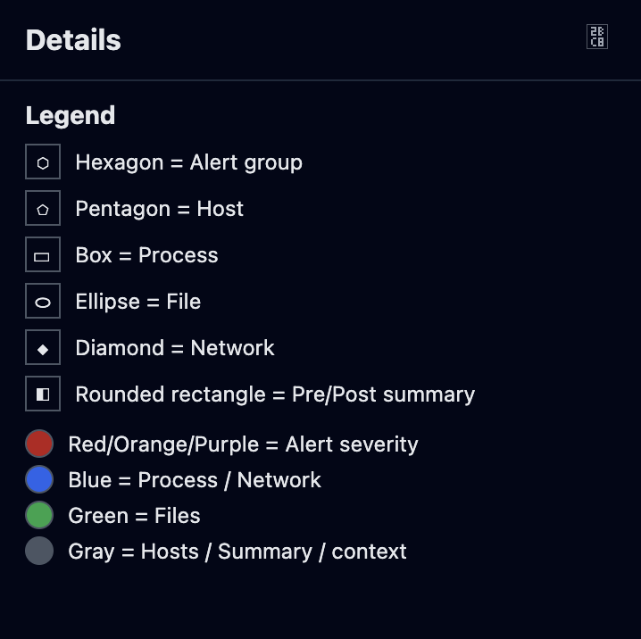
Shapes and Colors: Reading the Legend
Hexagon = Alert group (group of similar alerts).
Pentagon = Host (machine where alert fired).
Square/Rectangle = Process (program, e.g. /usr/bin/ssh).
Ellipse = File; Diamond = Network endpoint (IP:port).
Rounded rectangle = Before/After summary node.
Alert colors reflect severity (yellow/orange/red/purple).

Slide 6
Basic Navigation: Pan, Zoom, Hover
Pan: Click and drag the background to move the view.
Zoom: Use mouse wheel or trackpad to zoom in/out.
Hover over an icon to see a tooltip with key info.
Hover over an alert node: rule, host, alert count, time range, sample reasons.
Hover over a process/file/network node: see details specific to that object.

Slide 7
Filters and Time Window
Filter node types using checkboxes: Alerts, Processes, Files, Network, Summary.
Use filters to declutter: hide Files to focus on processes and network, for example.
Time dropdown: All, Last 5 min, 15 min, 1 hour, 24 hours.
Time filter hides edges whose events fall outside the selected window.
[Screenshot 6: Filters + Time controls highlighted]

Slide 8
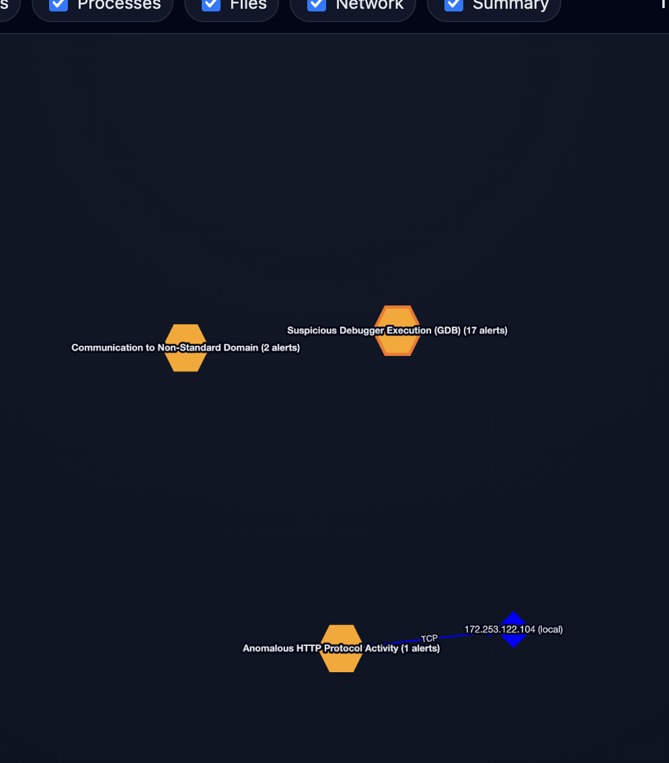
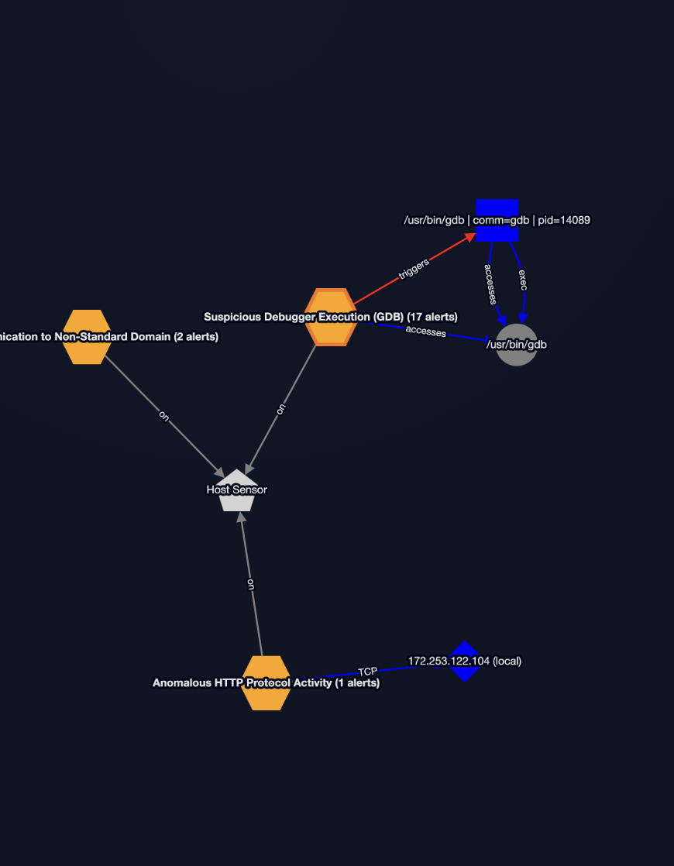
Expanding and Collapsing Neighbors
The graph starts with main alert nodes visible.
Click a node once → expand its neighbors (host, processes, network, files).
Click the same node again → collapse its neighbors (hide them).
Use this to reveal relevant context without overwhelming the view.

Slide 9
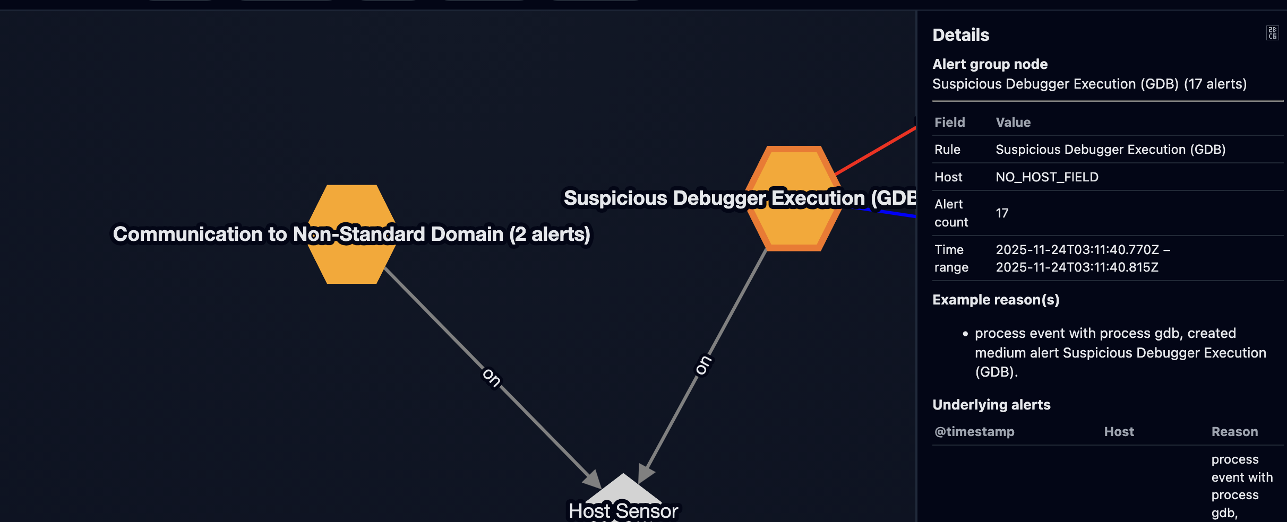
Details Panel: Alert Drill-Down
Click an alert hexagon to populate the Details panel on the right.
Panel shows: rule, host, alert count, time range, sample reasons.
Also shows a table of underlying alerts (from alerts.ndjson).
Compare these alerts with the same ones in Kibana for consistency.
Non-alert nodes show their basic info (process/file/network/host).

Slide 10
Typical Investigation Workflow
1. Start in Kibana Security → Alerts and select the given alert.
2. Open ASG visualizer and locate the matching alert hexagon.
3. Click the alert node and review the Details panel (who/what/when).
4. Expand neighbors to see host, processes, network, and files.
5. Use filters and time window to focus on relevant activity.
6. Use both views to answer: what happened, where, and via which process/path?

Slide 11
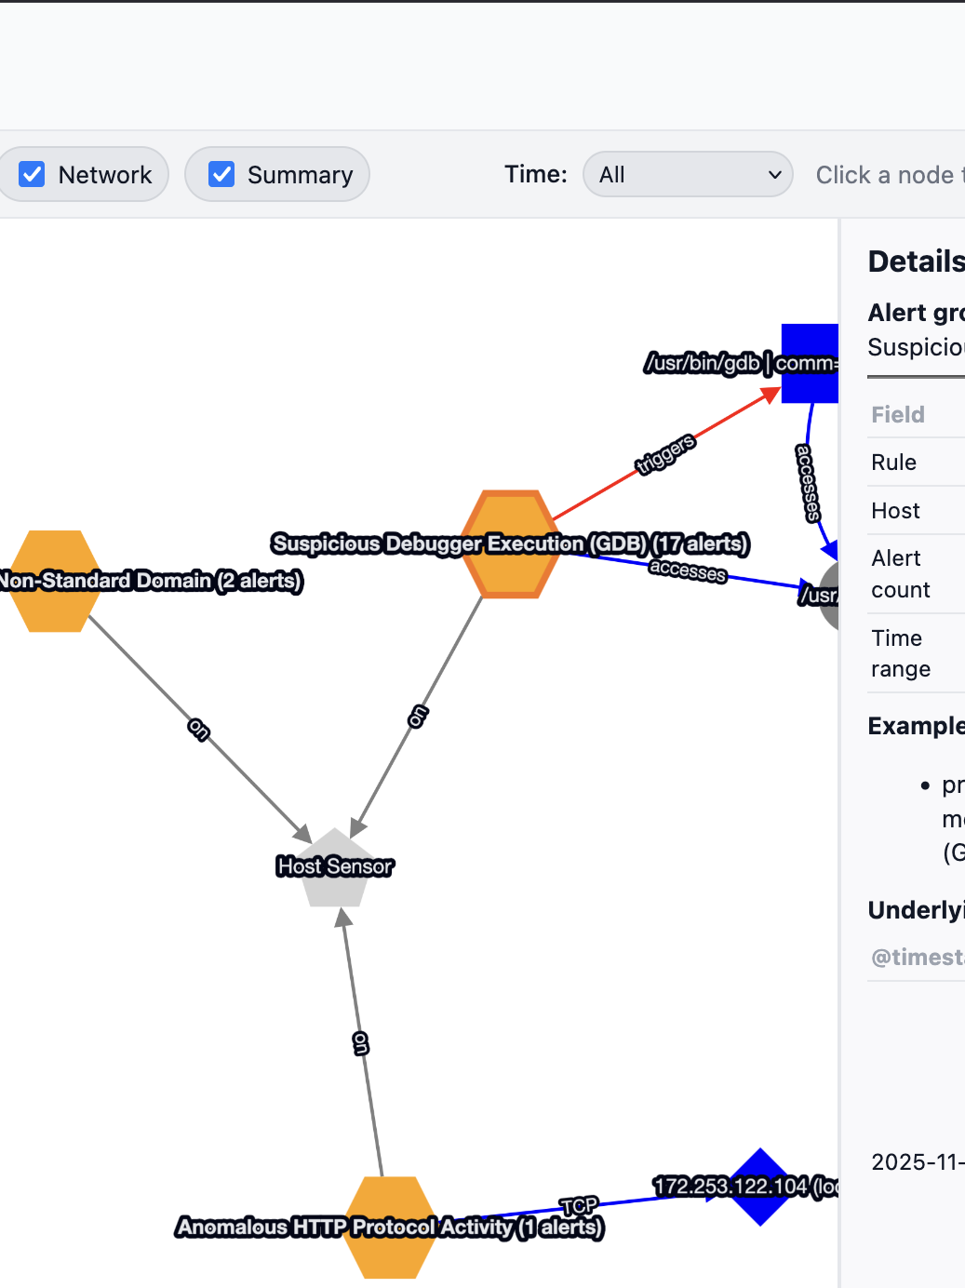
Light/Dark Mode and Tips
Use the moon/sun icon in the header to toggle dark vs. light mode.
If the graph feels busy, hide node types and collapse nodes to simplify.
Focus first on the alert node → host → process(es) → network/files chain.
Use ASG visualizer to ask: does the activity match the rule description?

Slide 12
Please add your findings in the ticket

